Slide 1
Final project
Alejandro yanez

Slide 2
objetive
This case study extends the CI/CD Pipeline Project with provisioning and monitoring components.
in this project the steps that I followed are:
Create a Jenkins(CI/CD) pipeline to deploy a Flask application onto a Kubernetes cluster created with Ansible.
Install and configure monitoring on the Kubernetes clusters and Flask application.
Use Prometheus/Grafana to monitor the cluster
Create a load with a tool like stress to simulate application activity.

Slide 3
Stage One
Project Desing
List of components in the architecture:
GitHub
Docker
Jenkins
Kubernetes (minikube)
Prometheus/Grafana

Slide 4
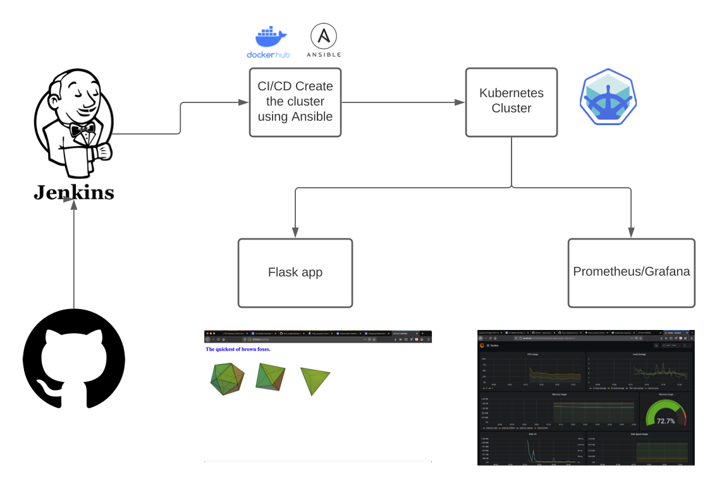

Slide 5
Stage Two
Deployment
Minikube will start the cluster locally
Deploy the Flask application in the cluster using Ansible
Check if the app is running

Slide 6
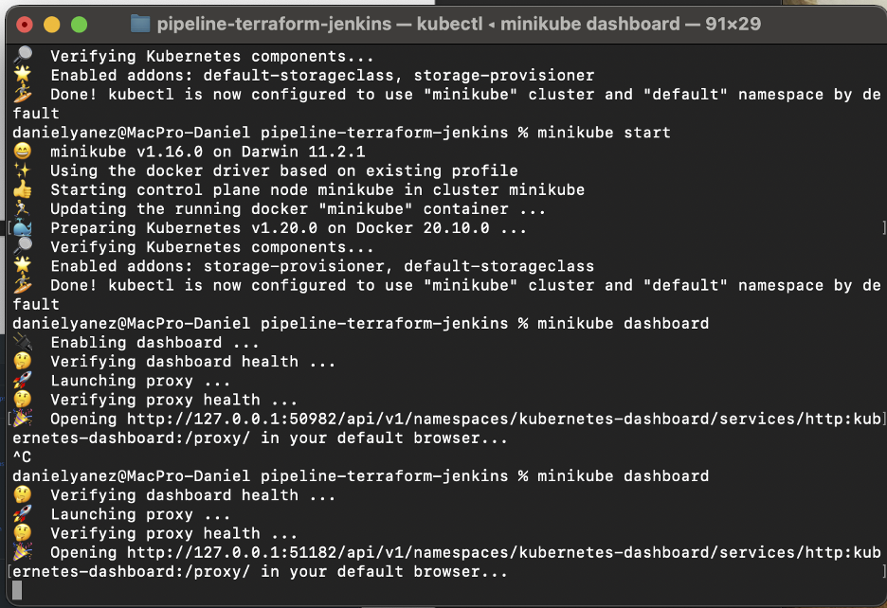

Slide 7
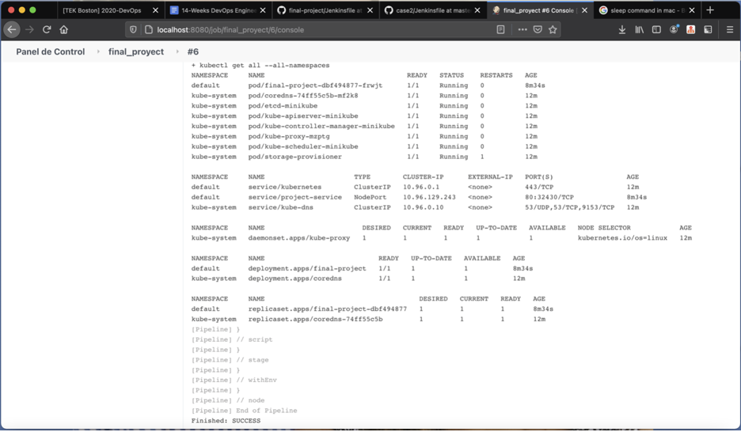

Slide 8
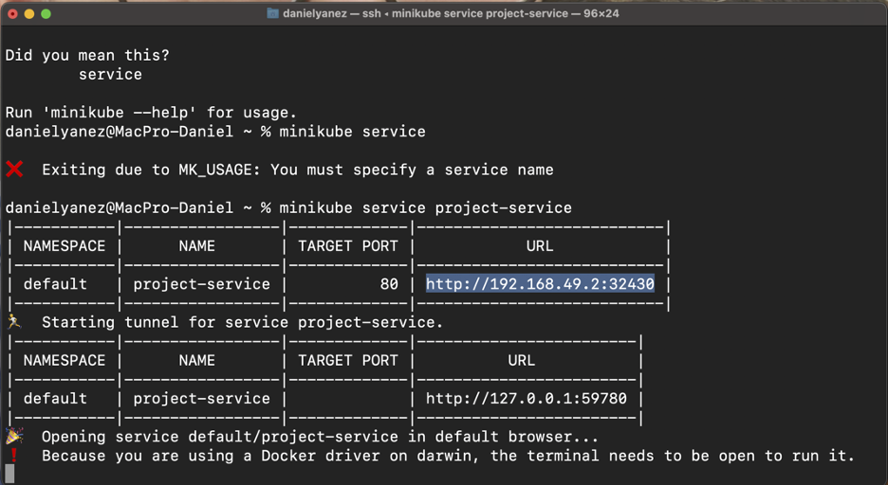
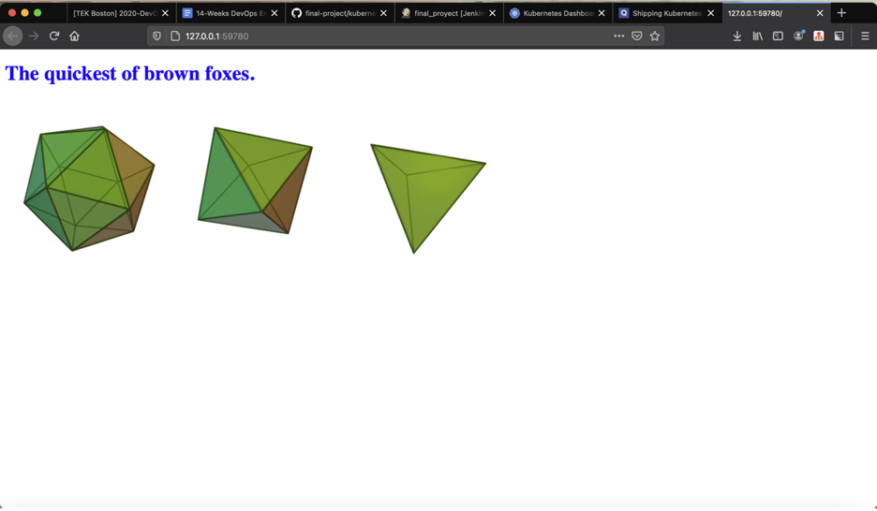

Slide 9
Stage Three
Monitoring
Download Prometheus/Grafana using Helm
Installing Prometheus/Grafana with Helm will automatically set it up
Port-forward the grafana pod to show the Dashboard on the browser in port 3000
Get the minikube cluster information
Get the information of the application pod
Stress the port where the applications is and see the difference

Slide 10
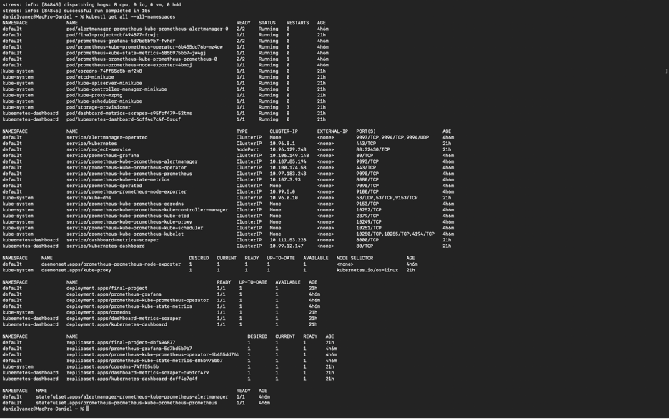

Slide 11
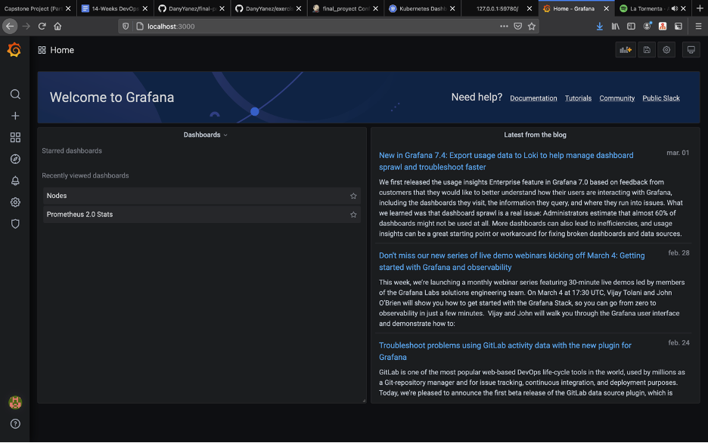

Slide 12
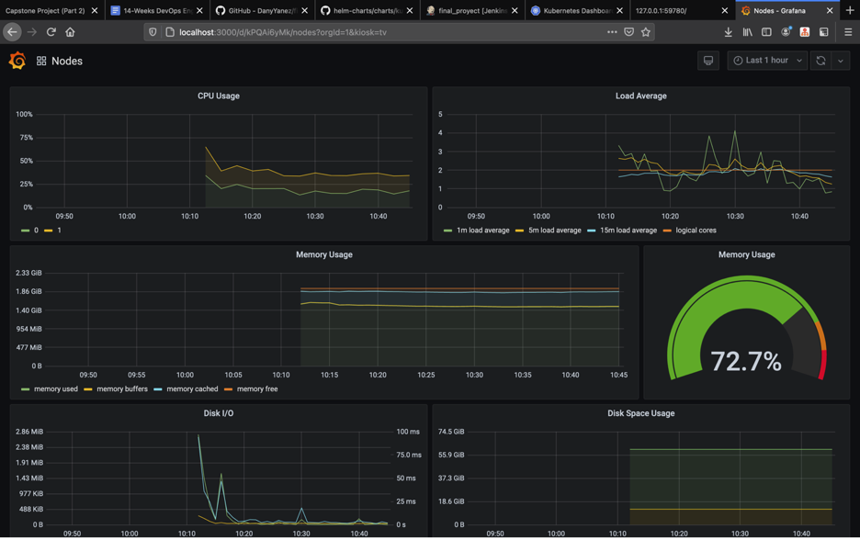
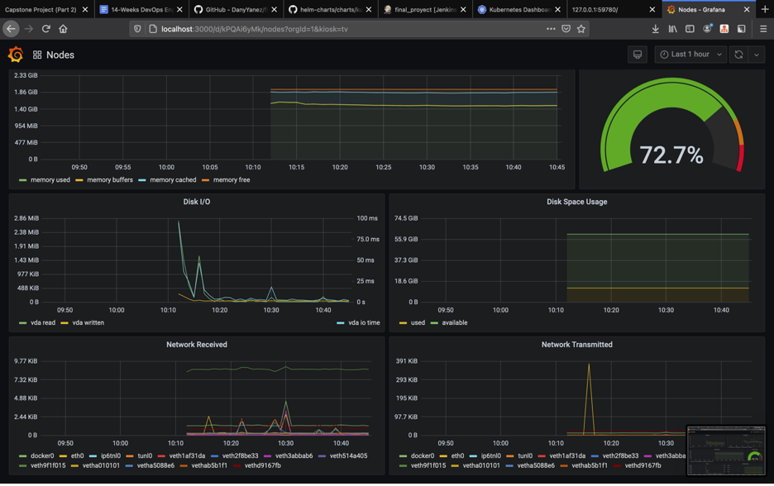
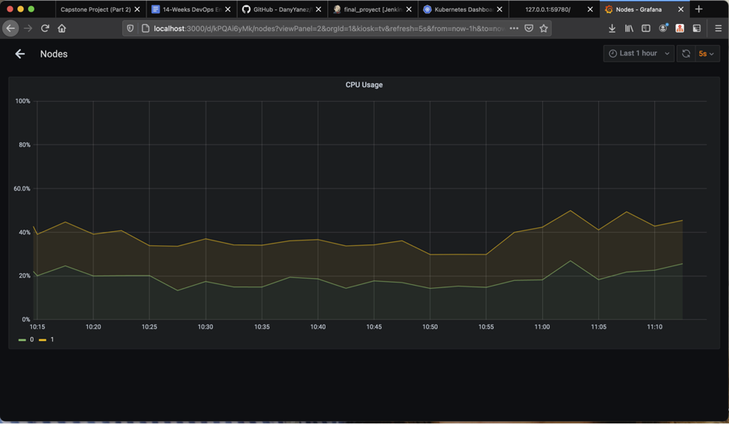
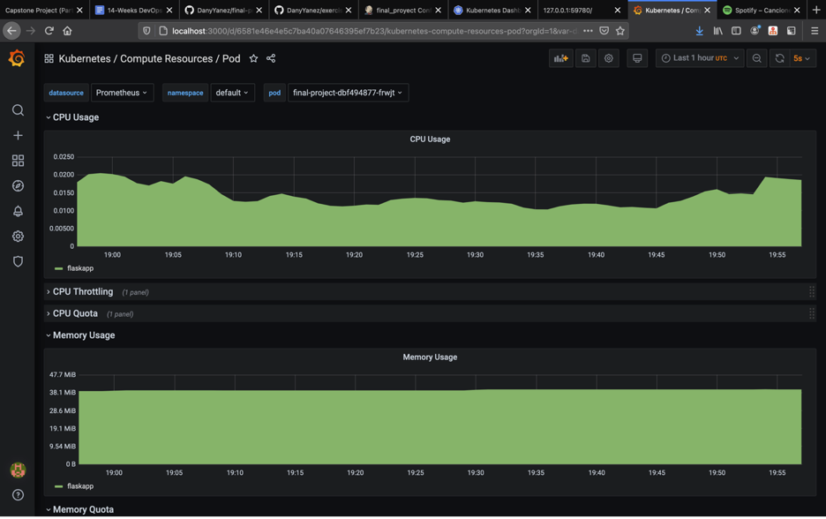

Slide 13
